Slide 1
Foundations of Data Science & Analytics: Preprocessing
Ezgi Siir Kibris
Introduction to Data Mining, 2nd Edition
by
Tan, Steinbach, Karpatne, Kumar
Data Preprocessing

Slide 2
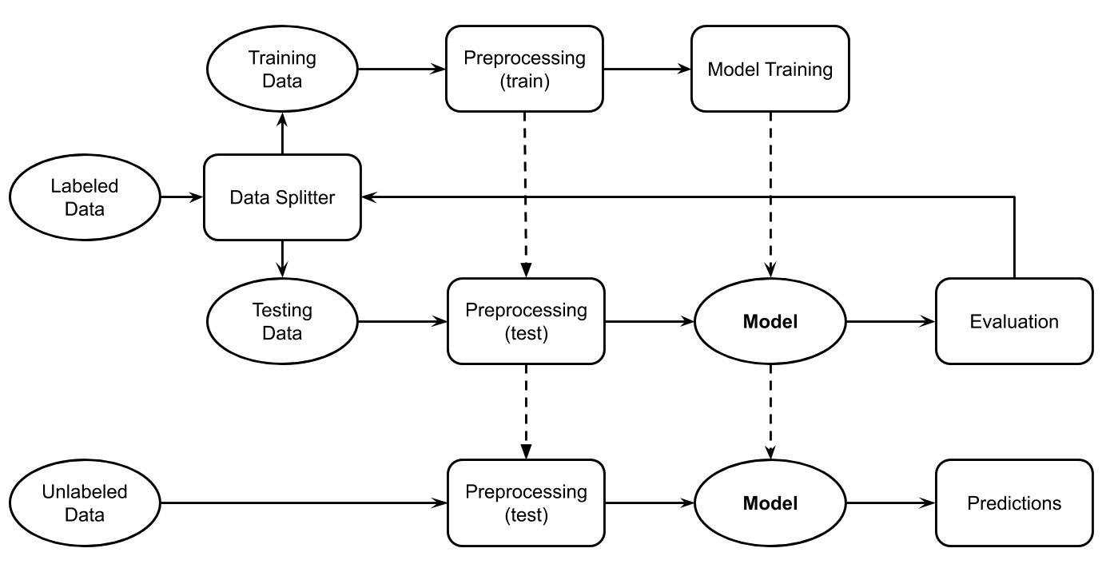
Data Mining / Machine Learning Pipeline
Data Preprocessing

Slide 3
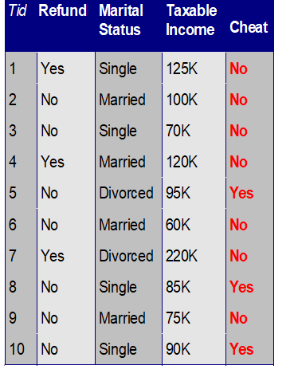
Preprocessing
Goal:
Transform raw data to a format that machine learning / data mining models can (easily) learn from.
Data Preprocessing

Slide 4

Preprocessing
1 | 0 | 1 | 0 | 1
0 | 1 | 0 | 1 | 0
1 | 0 | 1 | 0 | 1
I need to talk to you
i | need | to | talk | you
1 | 1 | 2 | 1 | 1
Data Preprocessing

Slide 5
Preprocessing
Manipulating Data (rows)
Sampling
Manipulating Values
Discretization
Normalization
Manipulating Features (columns)
Dimensionality Reduction
Feature Selection
Feature Creation
Only on training
Same on training, and test data
Data Preprocessing
Notes:
. Preprocessing techniques include sampling, normalization, discretization, and feature selection. The main goal is to prepare the data for modeling effectively.
This image shows a dataset with five columns and ten rows, representing different observations regarding tax-related information and a binary classification outcome of whether a person cheats on taxes.
Here's an explanation of each column:
Tid: This is a unique identifier for each record (or observation). It simply indexes each row from 1 to 10.
Refund: Indicates whether the person received a tax refund for the given year. This is a binary variable with values "Yes" or "No."
Marital Status: The marital status of the person. Possible values are "Single," "Married," and "Divorced."
Taxable Income: The taxable income of the person, given in thousands (K). For example, "125K" means the person has a taxable income of $125,000.
Cheat: This is the target variable, showing whether the person cheats on taxes. It is a binary outcome, with "Yes" meaning the person cheats and "No" meaning they do not cheat.
Example of data interpretation:
In Tid 1, the person received a refund, is single, has a taxable income of $125K, and does not cheat on taxes.
In Tid 7, the person did not receive a refund, is divorced, has a taxable income of $220K, and cheats on taxes.
This dataset could be used to train a machine learning model to predict whether someone cheats on taxes based on their marital status, taxable income, and whether they received a refund. It could also be useful in decision tree models to assess the impact of these factors on the likelihood of tax fraud.

Slide 6
Preprocessing
Supervised
Requires labels
Unsupervised
Does not rely on labels
Data Preprocessing

Slide 7
Preprocessing
Manipulating Data (rows)
Sampling
Manipulating Values
Discretization
Normalization
Manipulating Feature (columns)
Dimensionality Reduction
Feature Selection
Feature Creation
Data Preprocessing
Notes:
Sampling: Reducing the data size for better performance

Slide 8
Sampling
Reducing size of data
Random sampling
Stratified sampling
Data Preprocessing
Notes:
Random Sampling: Selection with or without replacement.Stratified Sampling: Ensures that the sampled data reflects the same distribution of classes in the original dataset, preventing important categories from being left out.

Slide 9
Reducing Size of Data
Random Sampling
Sampling without replacement
As each item is selected, it is removed from the population
Sampling with replacement
Objects are not removed from the population as they are selected for the sample.
The same object can be picked up more than once
Stratified sampling
Random sample from each class.
Keep the same distribution of classes.
Avoid the sampled data to miss some classes.
Unsupervised
Supervised
Data Preprocessing

Slide 10
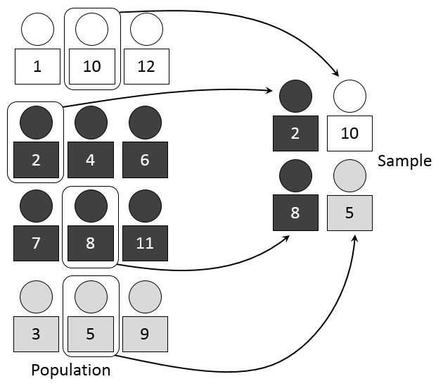
Stratified sampling
1 : 2 : 1
1 : 2 : 1
Data Preprocessing
Notes:
This image illustrates Stratified Sampling, a technique in statistics and data science used to ensure that subgroups (strata) of a population are proportionally represented in a sample. Stratified sampling divides the population into distinct categories or strata, then selects a sample from each stratum based on its proportion in the total population.
Explanation:
Population:
At the bottom of the image, you see the population divided into three groups (or strata), represented by circles with different shading:
Light-shaded (1, 10, 12)
Dark-shaded (2, 4, 6, 7, 8, 11)
Grey-shaded (3, 5, 9)
Stratified Sampling:
The process ensures that the sample maintains the same ratio of individuals from each group as in the population. In this example, the 1:2:1 ratio is used, meaning the sample will include 1 individual from the first group, 2 from the second group, and 1 from the third group.
For each stratum, individuals are selected:
From the first stratum (light-shaded), individuals 10 and 12 are part of the sample, but only 10 is chosen to maintain the ratio.
From the second stratum (dark-shaded), individuals 2, 4, 6, 8, 11 are available, and 2 and 8 are selected.
From the third stratum (grey-shaded), individuals 3, 5, and 9 are present, and 5 is selected.
Sample:
After stratified sampling is applied, the final sample consists of individuals 2, 10, 8, and 5. These individuals are selected in proportion to their representation in the population, maintaining the 1:2:1 ratio.
Key Points:
Stratified Sampling is especially useful when the population has distinct subgroups, and it ensures that each subgroup is appropriately represented in the sample.
This technique is often used in surveys and experiments where it's crucial to avoid underrepresenting any segment of the population.
The 1:2:1 ratio means that if, for example, there are four samples, one will be from the light-shaded group, two from the dark-shaded group, and one from the grey-shaded group.
This method increases the accuracy of the sample by reflecting the population structure, reducing sampling bias, and ensuring more reliable results.
4o

Slide 11
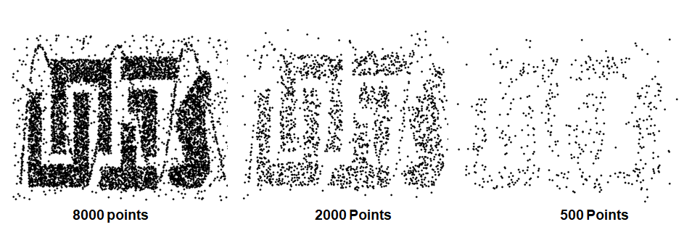
Example
Data Preprocessing

Slide 12
Preprocessing
Manipulating Data (rows)
Sampling
Manipulating Values
Discretization
Normalization
Manipulating Feature (columns)
Dimensionality Reduction
Feature Selection
Feature Creation
Data Preprocessing

Slide 13
Discretization
Discretization is the process of converting a continuous (Interval, Ratio) feature into an ordinal feature
A potentially infinite number of values are mapped into a small number of categories
Discretization is commonly used in classification
Many classification algorithms work best if both the independent and dependent variables have only a few values
Data Preprocessing

Slide 14
Types of features
Nominal
Examples: ID numbers, eye color, zip codes
Ordinal
Examples: rankings (e.g., taste of potato chips on a scale from 1-10), grades, height {tall, medium, short}
Interval
Examples: calendar dates, temperatures in Celsius or Fahrenheit.
Ratio
Examples: temperature in Kelvin, length, counts, elapsed time (e.g., time to run a race)
Data Preprocessing

Slide 15
Types of features
Distinctness: =
Order: < >
Differences are meaningful : + -
Ratios are meaningful * /
Nominal feature: distinctness
Ordinal feature: distinctness & order
Interval feature: distinctness, order & meaningful differences
Ratio feature: all 4 properties/operations
Data Preprocessing

Slide 16
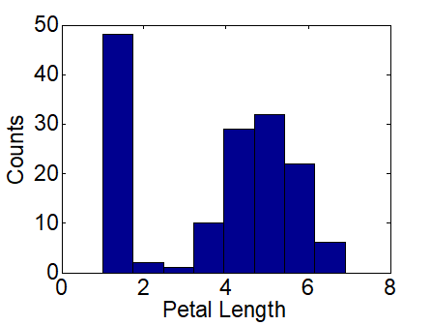
Discretization
How can we tell what the best discretization is?
Unsupervised discretization: find breaks in the data values
Example: Petal Length
Supervised discretization: Use class labels to find breaks
Data Preprocessing

Slide 17
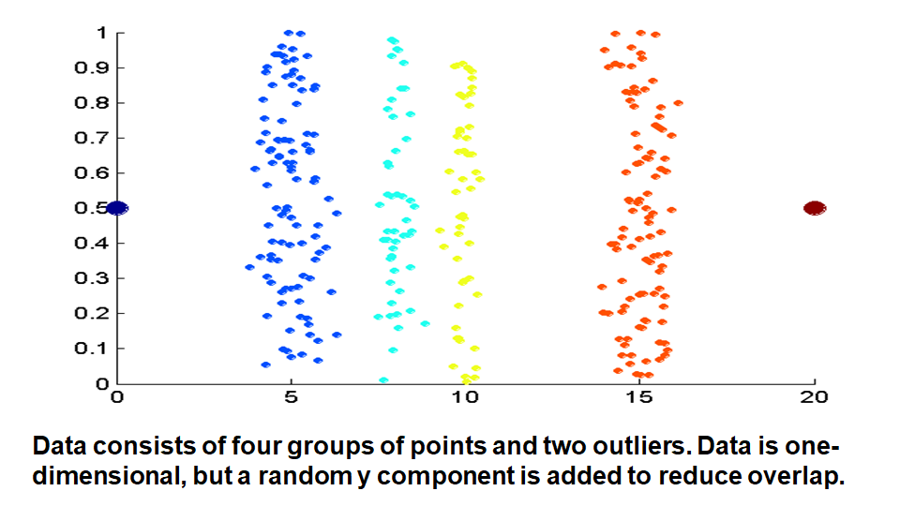
Unsupervised Discretization
Data Preprocessing

Slide 18
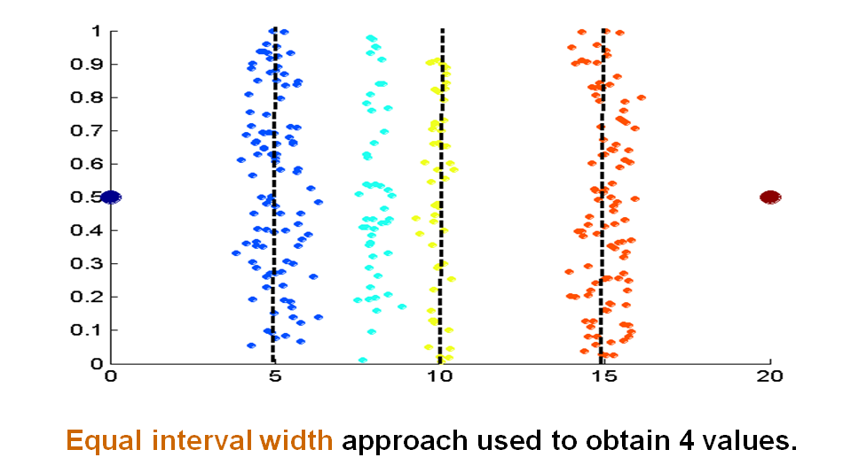
Unsupervised Discretization
Data Preprocessing

Slide 19
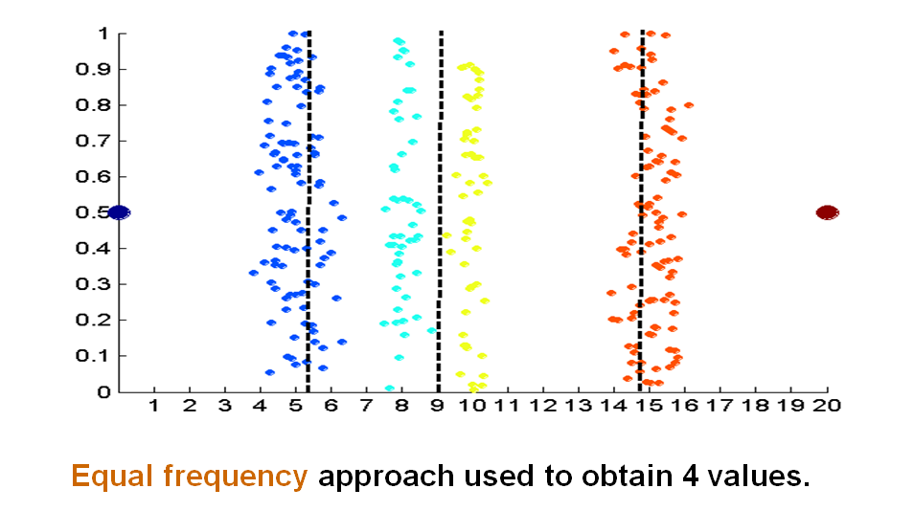
Unsupervised Discretization
Data Preprocessing

Slide 20
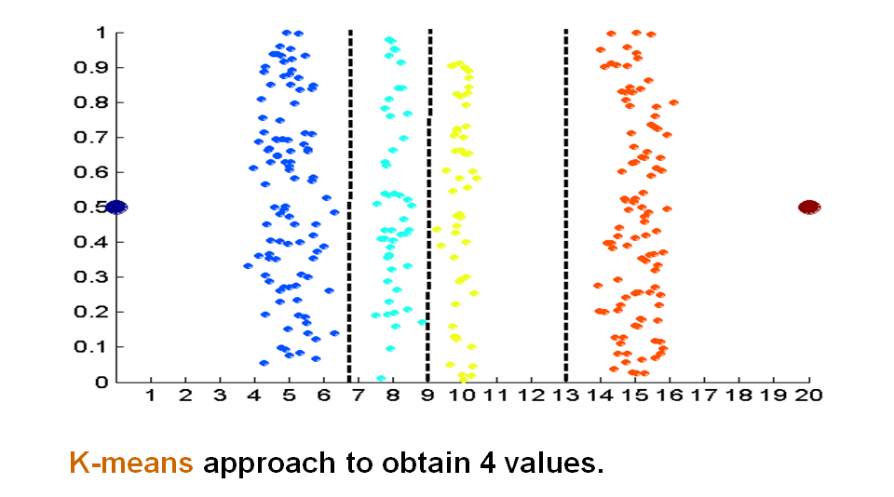
Unsupervised Discretization
Data Preprocessing

Slide 21
Supervised Discretization
Use entropy to find the best splits, like in decision trees.
Data Preprocessing

Slide 22
Preprocessing
Manipulating Data (rows)
Sampling
Manipulating Values
Discretization
Normalization
Manipulating Feature (columns)
Dimensionality Reduction
Feature Selection
Feature Creation
Data Preprocessing

Slide 23
Normalization
Make all features of the same scale (normalize columns)
Make each feature vector of unit length (normalize rows)
Data Preprocessing

Slide 24
Why Normalize?
Features may have to be scaled to prevent distance measures from being dominated by one of the features
Example:
height of a person may vary from 1.5 m to 1.8 m
weight of a person may vary from 90 lb to 300 lb
income of a person may vary from $10K to $1M
Data Preprocessing

Slide 25
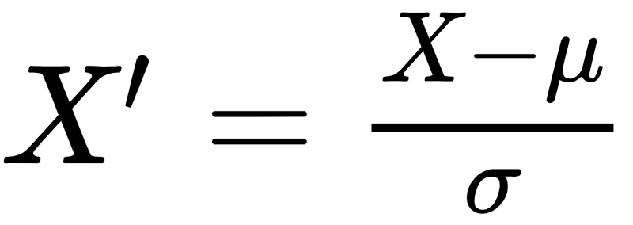
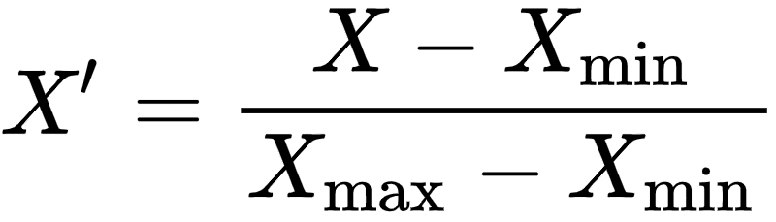
Normalization
Standard score (based on normal distribution)
Min-Max Feature scaling
Data Preprocessing
Notes:
Min-Max Scaling: Transforms features to a specific range (e.g., 0 to 1).
Standard Score (Z-score): Centers features around the mean with unit variance.

Slide 26
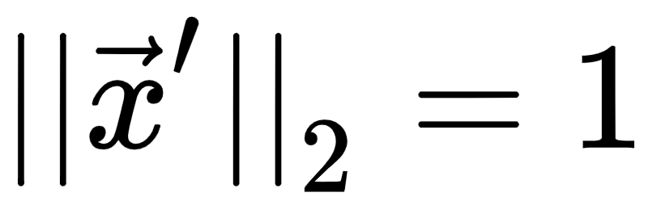
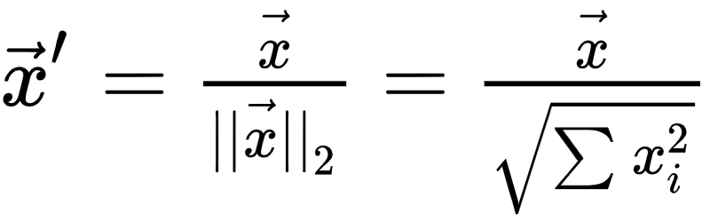
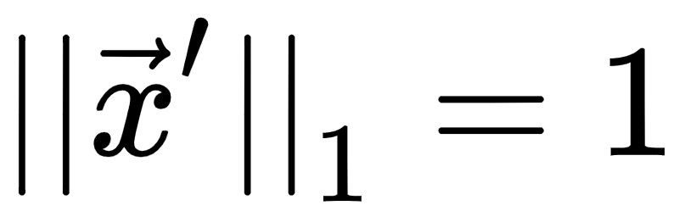
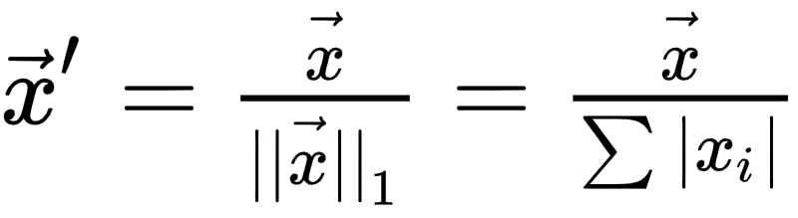
Normalization
L2 Normalization
L1 Normalization
X = [1,2,3,4]
sum_square = 1+4+9+16
L2_norm = sqrt(sum_square) = 5.48
X_norm = X / L2_norm = [1/5.48, 2/5.48, 3/5.48, 4/5.48]
sqrt(sum_square(X_norm)) = 1
Data Preprocessing
Notes:
L1 and L2 Normalization: Normalizes the feature vector by its L1 or L2 norm.

Slide 27
L2 Normalization on Columns
Training
X1_norm = 3.6
X2_norm = 123.7
X1 | X2
3 | 30
2 | 120
X1 | X2
0.83 | 0.24
0.55 | 0.97
X1_norm = 3.6
X2_norm = 123.7
Testing
X1 | X2
2 | 100
X1 | X2
0.55 | 0.81
Data Preprocessing

Slide 28
L2 Normalization on Rows
Training
norm1 = 30.15
norm2 = 120.02
X1 | X2
3 | 30
2 | 120
X1 | X2
0.100 | 0.995
0.017 | 0.999
Testing
norm = 100.02
X1 | X2
2 | 100
X1 | X2
0.020 | 0.999
Data Preprocessing

Slide 29
Preprocessing
Manipulating Data (rows)
Sampling
Manipulating Values
Discretization
Normalization
Manipulating Feature (columns)
Dimensionality Reduction
Feature Selection
Feature Creation
Data Preprocessing

Slide 30
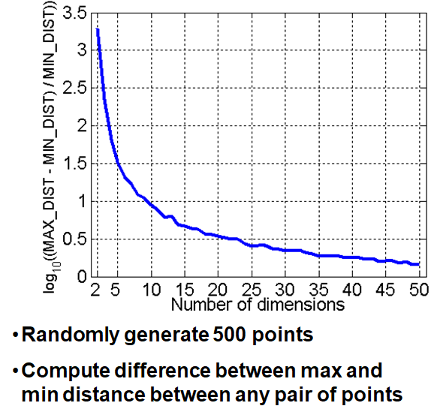
Curse of Dimensionality
When dimensionality increases, data becomes increasingly sparse in the space that it occupies
Definitions of density and distance between points, which are critical for clustering and outlier detection, become less meaningful
Data Preprocessing

Slide 31
Dimensionality Reduction
Purposes:
Avoid curse of dimensionality
Reduce amount of time and memory required by data mining algorithms
Allow data to be more easily visualized
May help to eliminate irrelevant features or reduce noise
Techniques
Principal Components Analysis (PCA)
Singular Value Decomposition
Others: supervised and non-linear techniques
Data Preprocessing
Notes:
Reducing dimensionality helps avoid the curse of dimensionality, where high-dimensional spaces make data sparse and difficult to model. Techniques like PCA are used to reduce the feature space while retaining key information.

Slide 32
Preprocessing
Manipulating Data (rows)
Sampling
Manipulating Values
Discretization
Normalization
Manipulating Feature (columns)
Dimensionality Reduction
Feature Selection
Feature Creation
Data Preprocessing

Slide 33
Feature Selection
Another way to reduce dimensionality of data
Redundant features (usually unsupervised)
Duplicate much or all of the information contained in one or more other features
E.g. purchase price of a product and the amount of sales tax paid
Irrelevant features (usually supervised)
Contain no information that is useful for the data mining task at hand
E.g. students' ID is often irrelevant to the task of predicting students' GPA
Correlation matrix
Data Preprocessing
Notes:
Feature Selection: Identifying and retaining only the most informative features, removing redundant or irrelevant ones.

Slide 34
Preprocessing
Manipulating Data (rows)
Sampling
Manipulating Values
Discretization
Normalization
Manipulating Feature (columns)
Dimensionality Reduction
Feature Selection
Feature Creation
Data Preprocessing

Slide 35
Feature Creation (unsupervised)
Create new features that can capture the important information in a data set much more efficiently than the original features
Three general methodologies:
Feature extraction
Example: extracting edges from images
Feature construction
Example: dividing mass by volume to get density
Mapping data to new space
Example: Fourier transform, kernel trick in SVM
Data Preprocessing
Notes:
Feature Creation: Generating new features that better represent the data's underlying structure, such as calculating new metrics or applying transformations like the Fourier transform.

Slide 36
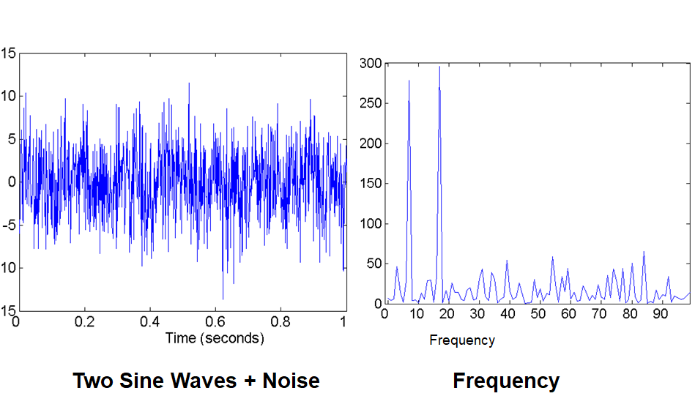
Fourier Transform
Data Preprocessing
Notes:
This slide explains the Fourier Transform, a method used to convert a signal from the time domain to the frequency domain.
Left Graph (Time Domain):
The signal consists of two sine waves mixed with noise.
The graph shows how the signal changes over time, but it’s hard to see the individual frequencies.
Right Graph (Frequency Domain):
After applying the Fourier Transform, we can see the frequencies that make up the signal.
The peaks in the graph represent the main frequencies (around 10 and 20 Hz), which are the two sine waves.
In summary, the Fourier Transform helps us break down a complex, noisy signal into its individual frequency components.

Slide 37
Assignment 2
Github!!!
Data Preprocessing

